Slide 1
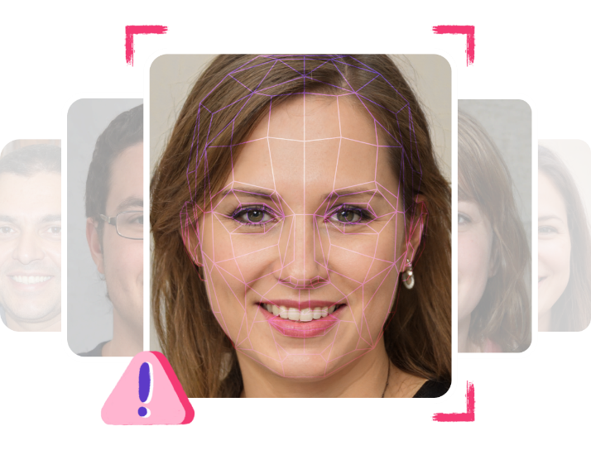
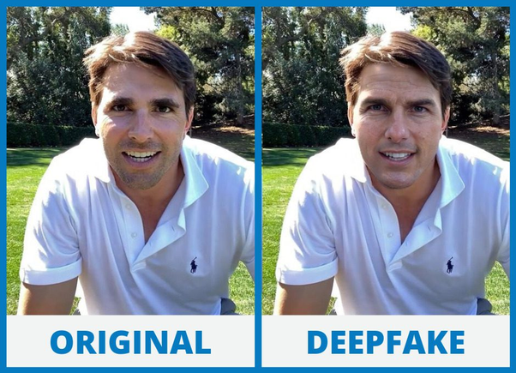
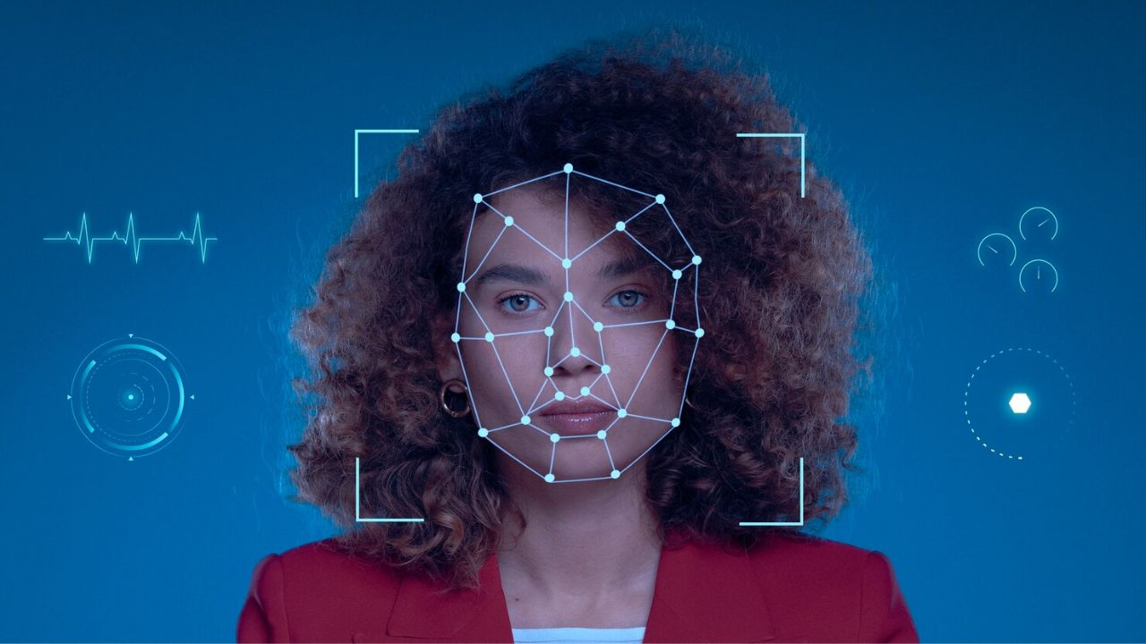
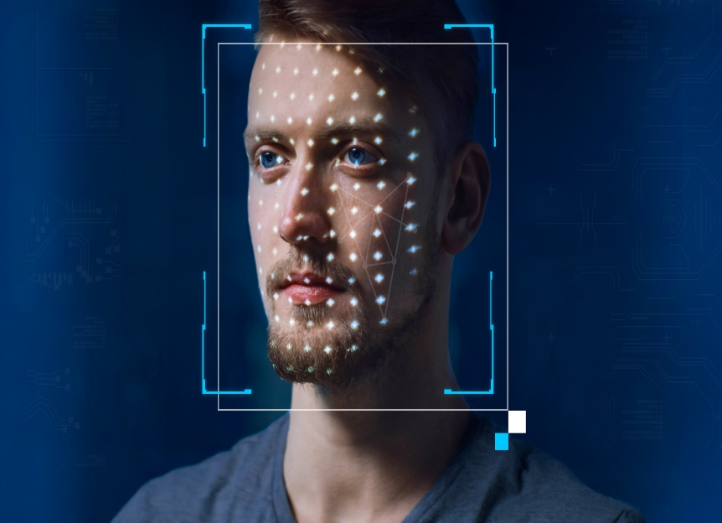
A MINI PROJECT PRESENTATION ON DEEPFAKE DETECTION
Under the Guidance
Of
Prof. DHAMMJYOTI V. DHAWASE
BY
Vaishnavi Yadav (A- 2164191242007)
Prajyot Panmand (A- 2164191242008)
Paras Patil (A- 2164191242013)
Narendra Rathore (A- 2164191242019)

Slide 2
CONTENTS
Introduction/Background
Aim and Project Objectives
Literature Survey
Proposed System
System Architecture /Methodology /System Overview
Dataset Exploration
Pre-processing
Model Architecture
Training Workflow
Prediction Workflow
Tools and Technologies
Applications
Conclusion
References

Slide 3
Tools and Technologies
Programming Languages
Python3
JavaScript
Programming Frameworks
PyTorch
Django
IDE
Google Collab
Jupyter Notebook
Visual Studio Code
Cloud Services
Google Cloud Platform
Version Control
Git

Slide 4
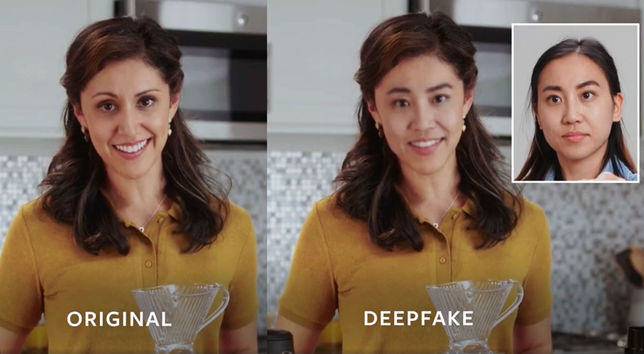
INTRODUCTION
Deep fake is a technique for human image synthesis based on artificial intelligence.
Deep fakes are created by combing and superimposing existing images and videos onto source images or videos using a deep learning technique known as generative adversarial network.

Slide 5
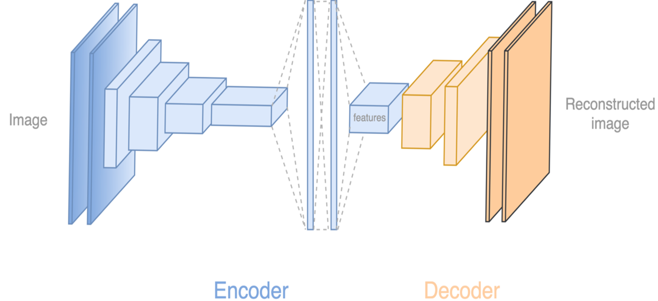
How Deep Fakes Are Created ?
Tools for deep fake creation
Faceswap
Faceit
DeepFaceLab
DeepfakeCapsuleGAN
Large resolution facemasked

Slide 6
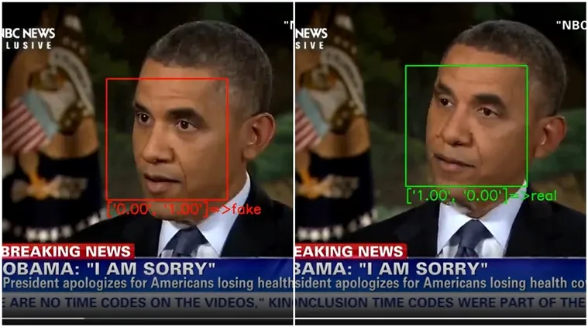
Why Deep Fake Detection ?
Fake News
Malicious hoaxes
Financial fraud
Celebrity unusual video

Slide 7
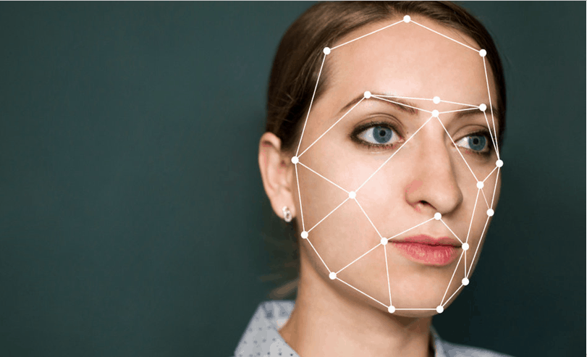
AIM/OBJECTIVE
Implementation of user friendly and scalable UI
Fine tuning with latest and diverse datasets

Slide 8
Proposed work flow
Major Tasks in the Project stages are
• Task 1: Data-set gathering and analysis
• Task 2 : Module 1 implementation
• Task 3: Pre-processing
• Task 4: Module 2 implementation
• Task 5 : Hyper parameter tuning
• Task 6 : Training the final model
• Task 7 : Front end Development
• Task 8 : Testing

Slide 9
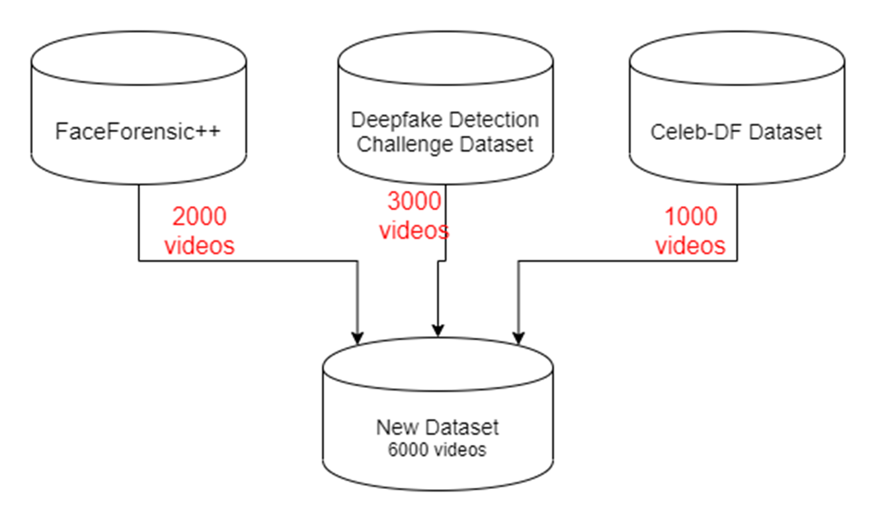
Dataset Exploration

Slide 10
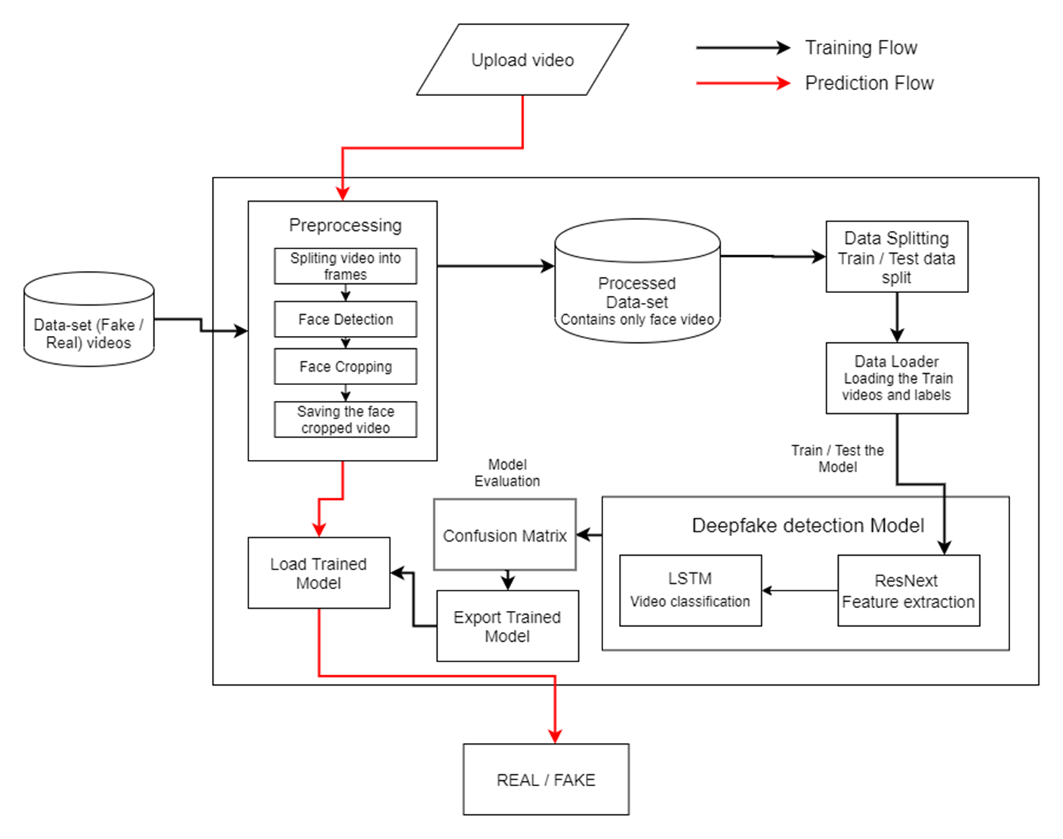
System architecture and overview

Slide 11
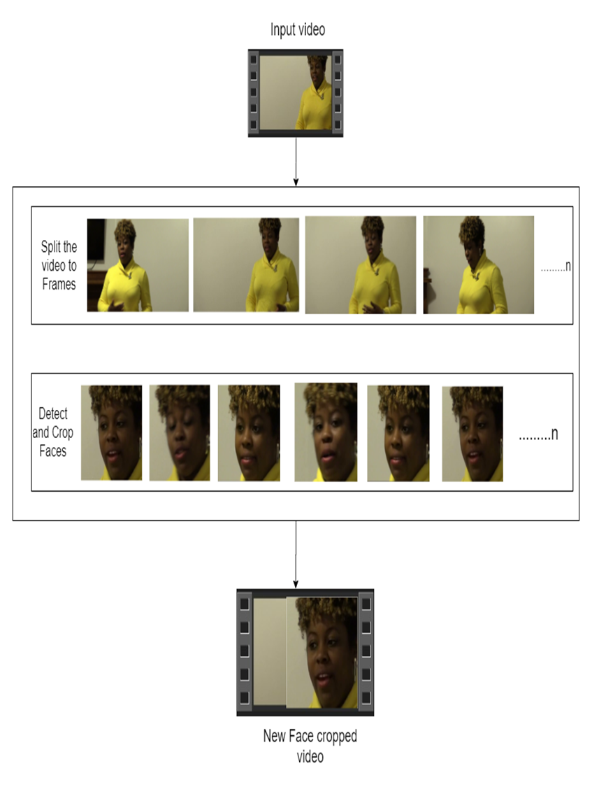
Pre-processing
Split video into frames
Face detection
Cropping face
Creating new face cropped video
Saving the face cropped video

Slide 12
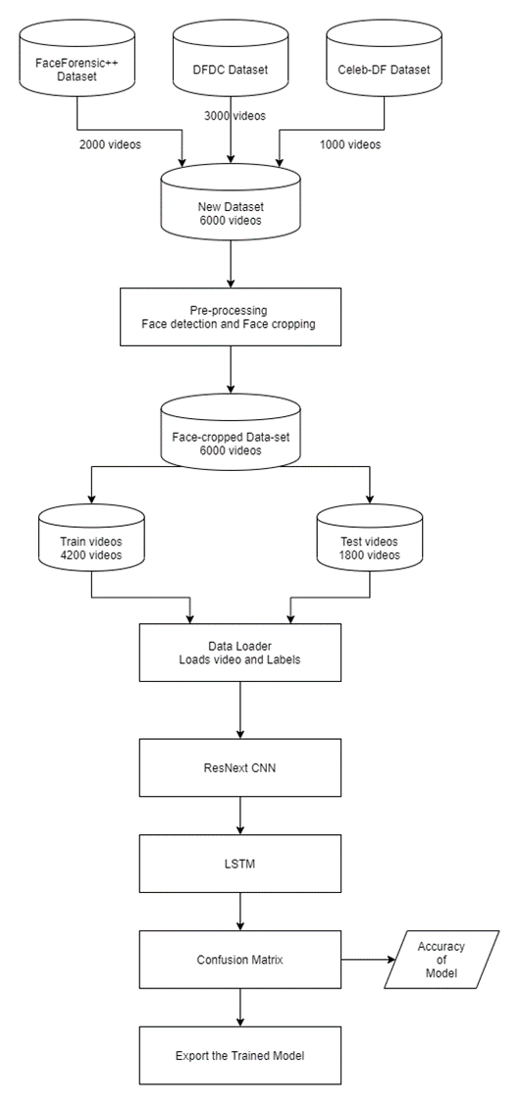
Training Workflow

Slide 13
APPLICATIONS
Media Integrity: Deepfake detection can be used to preserve the integrity of media content, such as identifying and flagging deepfake videos to prevent the spread of misinformation and fake news
Forensic Analysis: In forensic investigations, deepfake detection can help in authenticating digital evidence by identifying manipulated or synthetic media
Security and Privacy: Deepfake detection technologies can be employed to safeguard individuals' privacy and prevent potential misuse of manipulated videos for extortion or defamation
Regulatory Compliance: In the context of content moderation and regulatory compliance, deepfake detection can assist platforms and organizations in identifying and removing illicit or harmful deepfake content

Slide 14
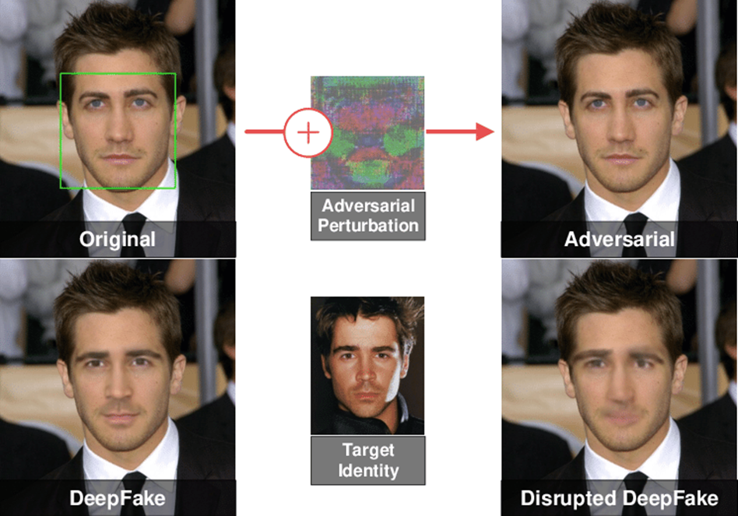
CONCLUSION
In conclusion, deepfake detection is a crucial technology that can be used to preserve the integrity of media content, authenticate digital evidence, safeguard individuals' privacy, and assist platforms and organizations in identifying and removing illicit or harmful deepfake content. With the proliferation of synthetic media, deepfake detection has become increasingly important in addressing the challenges posed by the spread of misinformation and fake news. Machine learning algorithms are commonly used in deepfake detection, and ongoing research is focused on improving the accuracy and efficiency of these algorithms

Slide 15
FUTURE SCOPE
There is always a scope for enhancements in any developed system, especially when the project build using latest trending technology and has a good scope in future.
Web based platform can be upscaled to a browser plugin for ease of access to the user.
Currently only Face Deep Fakes are being detected by the algorithm, but the algorithm can be enhanced in detecting full body deep fakes.

Slide 16
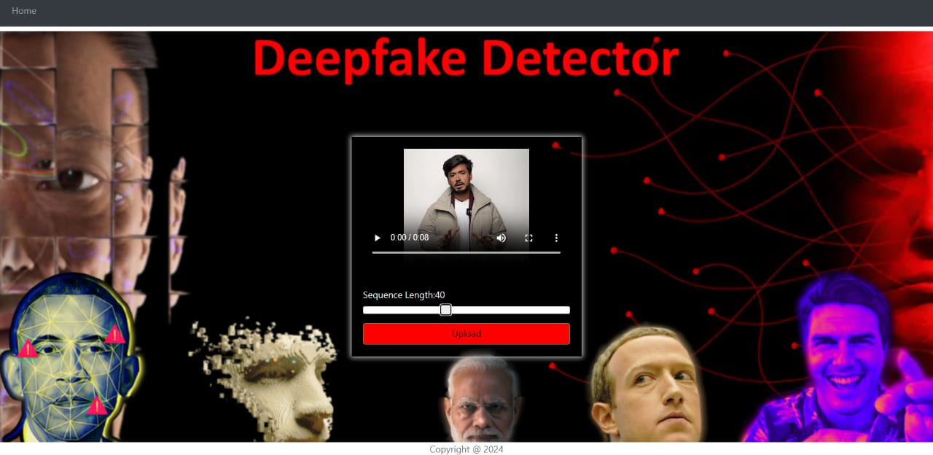
OUTPUT

Slide 17
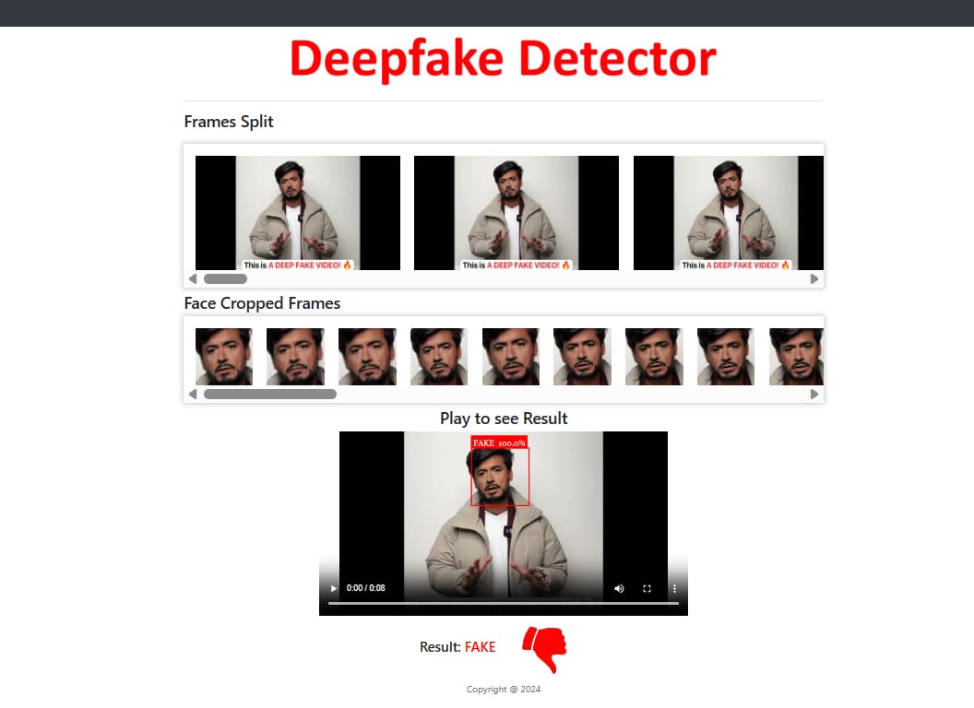
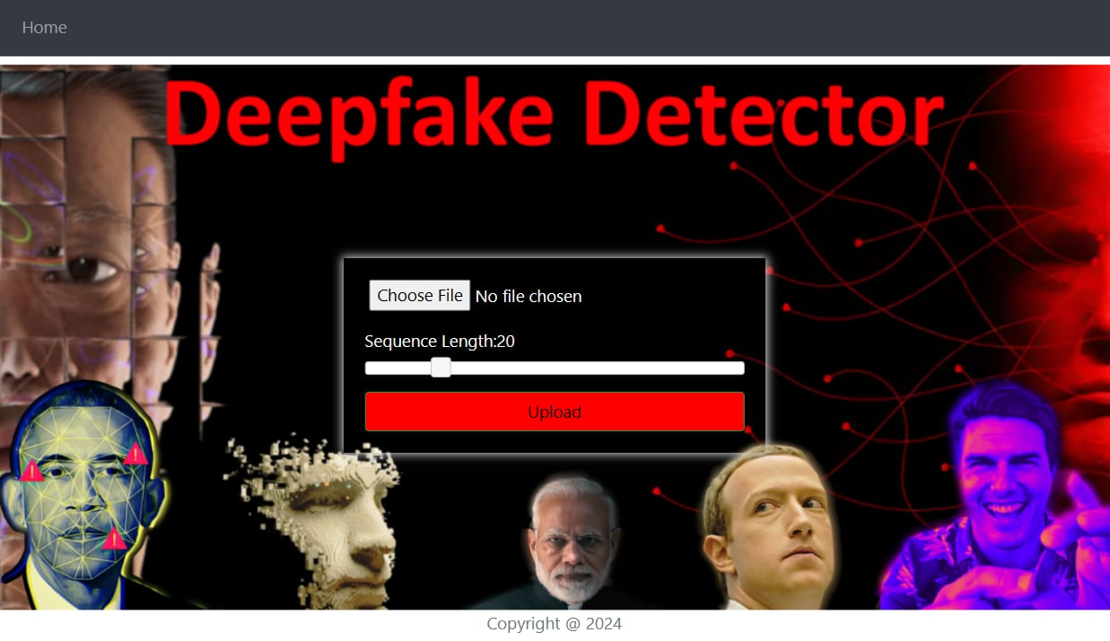

Slide 18
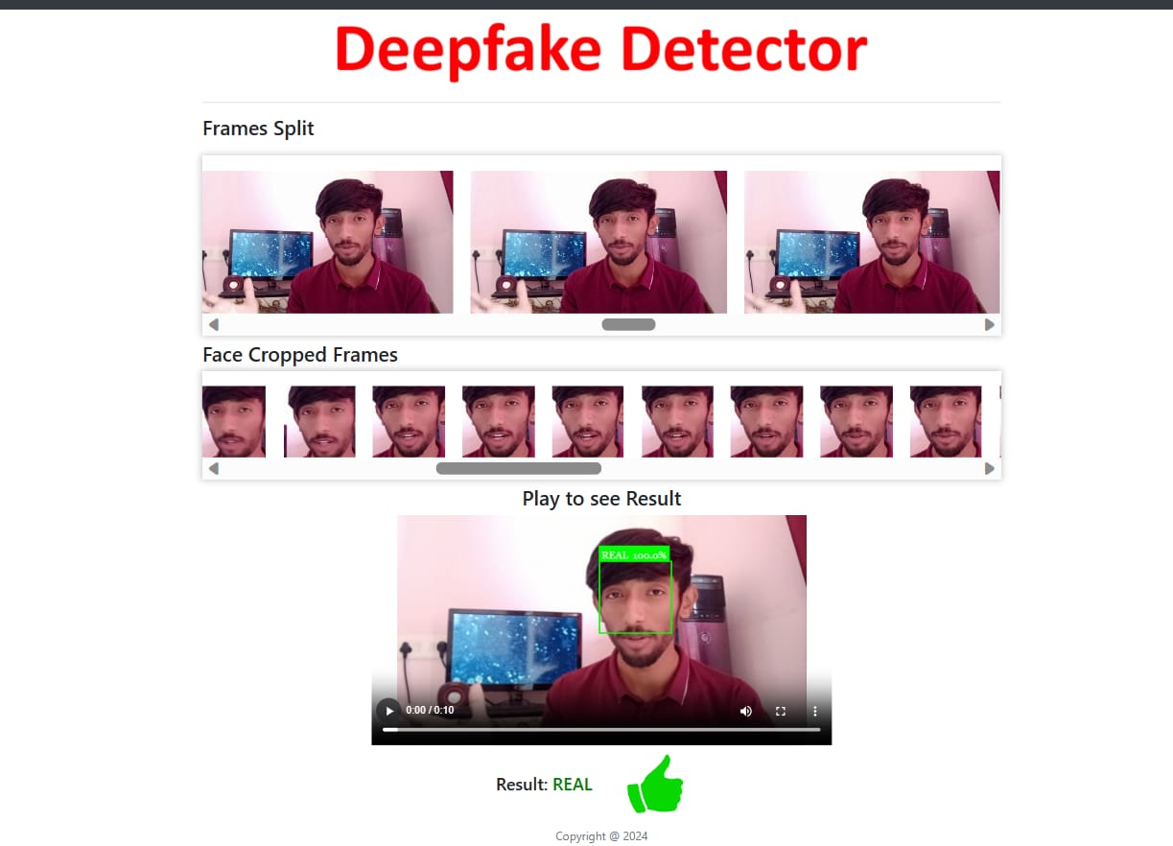
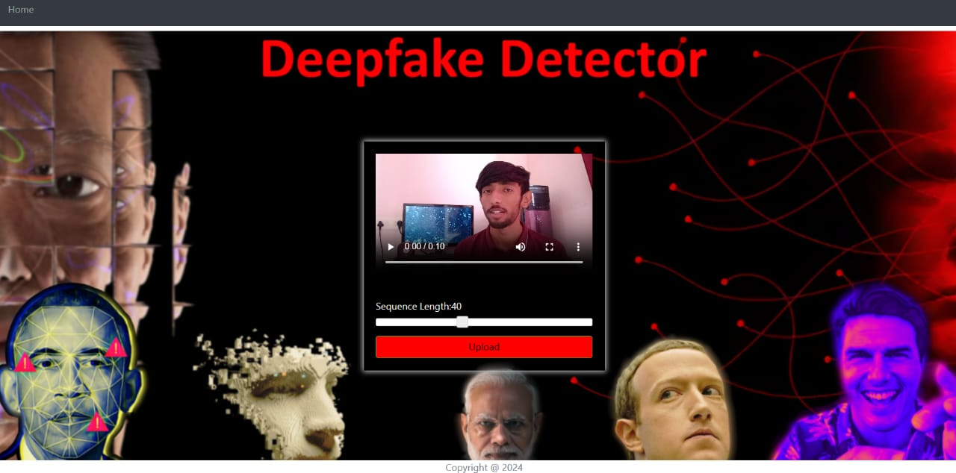

Slide 19
LITERATURE SURVEY
Sr. No | Paper Name, Year | Datasets | Methods/ Techniques | Accuracy | Advantage | Disadvantage | Future scope
1. | Deepfakes Detection Techniques Using Deep Learning: A Survey 2021 | 1) FFHQ; 2) 100K-Faces; 3) DFFD; 4) CASIA-WebFace; 5)VGGFace2 and (6) The eye-blinking dataset; 7) DeepfakeTIMIT | CNN, RNN, LSTM Biological Analysis | - | The model employs a Siamese network architecture for concurrent extraction of speech and face modalities. | The current deep learning methods need to improve as well to successfully identify fake videos and images | Current deep learning lacks clear methods for determining optimal layer count and selecting appropriate architecture in deepfake detection.
2. | Using Deep Learning to Detecting Deepfakes 2022 | Celeb-DF v2, DeepfakeTIMIT, FaceForensics++, Celeb-DF | CNN. ResNet18, Temporal Feature Deepfake Detection Method | 92% | Provides a good benchmark to compare models to each other, as results can be heavily dependent on the dataset applied | One issue that plagues many deepfake models is their lack of transferability | Developing models that are able to perform well on multiple different databases in order to prepare this technology to be applied in a real-world context and aid people online around the world.
3. | Deepfake Video Detection 2020 | Faceforensics++ and MesoNet, DFDC | RNN, DeepVision, Meso4 | 89% | There Are Benefits to Correlations and Regression Analysis | Accuracy is potentially not as high as it is claimed to be | This project highlights the importance of continuously testing previous detection methods to assess their ongoing effectiveness in identifying deepfake content.
4. | A Machine Learning Based Approach for Deepfake Detection in Social Media Through Key Video Frame Extraction 2021 | FF++, DFDC | CNN, GAN, DNN | 90% | An algorithm which cuts down the computational burden significantly has been proposed. | We avoided training with enormous amounts of data even though we accommodated a large number of videos. | Reducing the run-time memory and the model size would be a great effort as the future work.
5. | Deepfake Detection: A Systematic Literature Review 2022 | FF, FF++, DFD, DFDC, FD-TIMIT, SMFW | RNN, CNN, GANs | - | It can be stated that, in general, the deep learning models outperform the non-deep learning models. | Construct validity, internal validity | This SLR provides a valuable resource for the research community in developing effective detection methods and countermeasures.

Slide 20
6. | A survey on deepfake video detection datasets 2022 | DeepFakeDetection, Faceforensics++, DeeperForensics-1.0 | Celeb-DF-v2, GAN (FSGAN), FOMM, ATFHP, and Wav2Lip | - | Universal detection model since fake video creation technology has improved a lot. | The results show detection scores of the datasets are high for some models and also have lower performance scores | It is very expected that further competitive deepfake detection models will comes up in future articles with most accurate results
7. | Deepfake Detection: A Comprehensive Study from the Reliability Perspective 2022 | UADFV, DeepfakeTIMIT, FF++ | GAN | 91% | Interpretability, transferability | Robustness challenges is not yet accomplished in the current research domain | Tracing original sources of synthetic contents and recovering synthetic operation sequences
8. | Deepfake Detection: A Comparative Analysis 2022 | FakeAVCeleb, CelebDFV2, DFDC, and FaceForensics++ | CNN, Xception | - | Achieve better overall performance in intra-dataset comparison | They do not provide the models with any generalisation capability | Self-supervised training strategies to train models, as well as try to incorporate knowledge distillation
9. | A GAN-Based Model of Deepfake Detection in Social Media 2022 | DDFD; 100K-Faces; FFHQ ; Deepfake TIMIT; VGGFace2; the eye-blinking dataset; CASIA-WebFac | GAN | 91% | Discusses the performance of deep convolution GAN for 10 successive iterations. | Losses of discriminator get decrease while of generator increases with each successive iteration | To improve the handling of small datasets and overcome GAN constraints
10. | Deepfake Video Detection Using Convolutional Neural Network 2022 | Celeb-DF | CNN, RNN | 93% | The proposed model works well and is able to successfully gather features required for further processing to test for deepfakes. | It is observed that the accuracy of the proposed model decreases with low quality images and with medium quality video | Research in the field of image & video forgery and digital media forensics.
11. | Short And Low Resolution Deepfake Video Detection Using CNN 2022 | DFDC, FF++ | CNN | 92% | Convolutional Neural Network (CNN) [6] can accurately predict whether or not a video has been manipulated | It is so hard to discover deepfake recordings where the manipulation is just present in a little part of the video | How we may improve our system’s robustness against altered videos by using unknown techniques during training.
12. | A Review of Deep Learning-based Approaches for Deepfake Content Detection 2022 | Celeb-DF, and DeepfakeDetection (DFD), FF++ | Face2Face, FaceSwap, SVM | 91% | Complexity and realism of deepfake methods are actively refined as a consequence of the advances in deep learning techniques | Time-consuming and laborious manual annotation of massive amounts of new data | Dynamic procedure or even the combination of supervised and unsupervised learning to rapidly identifying and actively tracking the patterns

Slide 21
13. | Deepfake Attacks: Generation, Detection, Datasets, Challenges, and Research Directions 2022 | FF++, DFDC, Celeb-DF, WildDeepfake | StyleGAN, AttGAN | 91% | Forgery detection without capturing the intricacies and subtleties of advanced deepfakes | The quality of the deepfake datasets is yet another prominent challenge in deepfake detection. | Focus on finding a balance between utilizing deepfakes’ beneficial potential and reducing their negative effects
14. | Deepfake Detection with Deep Learning: Convolutional Neural Networks versus Transformers 2022 | FF++, DFDC, Celeb-DF | CNN | 92% | Models performed very well consistently when trained | Models trained on the Deeper Forensics dataset fared poorly when tested on the other datasets. | Future works along with newer and more sophisticated deepfakes datasets.
15. | Detecting Deepfake Images Using Deep Learning Techniques and Explainable AI Methods 2022 | FFHQ | CNN,DNN, XAI | 90% | Correctly identify real images to make the model trustworthy | XAI is limited to images, but in the future, video samples could be validated by XAI | Researchers may have to look at medical images to implement and get the best outcome from deepfake detection for further medical analysis
16. | ResViT: A Framework for Deepfake Videos Detection2022 | DFDC2, Celeb-DF | ResVIT | 92% | We use a couple of libraries like BlazeFace and MTCNN for face extraction, known as the rapid processing of large amounts of images | We present the training and validation losses and accuracy on three sample datasets for the proposed ResViT | Performance of the ResViT under massive datasets with more baseline models
17. | DEEPFAKE DETECTION THROUGH DEEP LEARNING USING RESNEXT CNN AND LSTM 1 2022 | FF++, DFDC, Celeb-DF | CNN , RNN | 93% | It can accurately predict the output by analyzing just one second of video | Integrating it into a larger sof | Processing the temporal sequence and identifying changes between consecutive frames.
18. | Deepfake Detection on Social Media: Leveraging Deep Learning and fasttext Embeddings for Identifying Machine-Generated Tweets 2016 | DFDC | CNN, LSTM, SGC | 87% | The adoption of a CNN model structure in this Study shows its superiority in terms of simplicity, computational efficiency | No higher accuracy | The quantum NLP and other cutting-edge methodologies will be applied for more sophisticated and efficient detection systems

Slide 22
REFERENCES
[1] Andreas Rossler, Davide Cozzolino, Luisa Verdoliva, Christian Riess, Justus
Thies,Matthias Nießner, “FaceForensics++: Learning to Detect Manipulated Facial
Images” in arXiv:1901.08971.
[2] Deepfake detection challenge dataset : https://www.kaggle.com/c/deepfake-detectionchallenge/data Accessed on 26 March, 2020
[3] Yuezun Li , Xin Yang , Pu Sun , Honggang Qi and Siwei Lyu “Celeb-DF: A
Large-scale Challenging Dataset for DeepFake Forensics” in arXiv:1909.12962
[4] Deepfake Video of Mark Zuckerberg Goes Viral on Eve of House A.I. Hearing :
https://fortune.com/2019/06/12/deepfake-mark-zuckerberg/ Accessed on 26 March,
2020
[5] 10 deepfake examples that terrified and amused the internet :
https://www.creativebloq.com/features/deepfake-examples Accessed on 26 March,
2020
[6] TensorFlow: https://www.tensorflow.org/ (Accessed on 26 March, 2020)
[7] Keras: https://keras.io/ (Accessed on 26 March, 2020)

Slide 23
[8] PyTorch : https://pytorch.org/ (Accessed on 26 March, 2020)
[9] G. Antipov, M. Baccouche, and J.-L. Dugelay. Face aging with conditional generative adversarial networks. arXiv:1702.01983, Feb. 2017
[10] J. Thies et al. Face2Face: Real-time face capture and reenactment of rgb videos.
Proceedings of the IEEE Conference on Computer Vision and Pattern Recognition,
pages 2387–2395, June 2016. Las Vegas, NV.
[11] Face app: https://www.faceapp.com/ (Accessed on 26 March, 2020)
[12] Face Swap : https://faceswaponline.com/ (Accessed on 26 March, 2020)
[13] Deepfakes, Revenge Porn, And The Impact On Women :
https://www.forbes.com/sites/chenxiwang/2019/11/01/deepfakes-revenge-porn-andthe-impact-on-women/
[14] The rise of the deepfake and the threat to democracy :
ttps://www.theguardian.com/technology/ng-interactive/2019/jun/22/the-rise-ofthe-deepfake-and-the-threat-to-democracy(Accessed on 26 March, 2020)
[15] Yuezun Li, Siwei Lyu, “ExposingDF Videos By Detecting Face Warping Artifacts,” in arXiv:1811.00656v3.
[16] Yuezun Li, Ming-Ching Chang and Siwei Lyu “Exposing AI Created Fake
Videos by Detecting Eye Blinking” in arXiv:1806.02877v2.

Slide 24


